Slide 1

50.039 Theory and Practice of Deep Learning W2-S2 Neural Networks, Initializers, Optimizers and other Good Practices
Matthieu De Mari

Slide 2
About this week (Week 2)
What are the typical initializers for trainable parameters in Neural Networks?
What is symmetry in a Neural Network and why is it essential to break it with proper initializers?
What is the exploding gradient problem?
How to spot and fix an exploding gradient problem?
What is the vanishing gradient problem?
How to spot and fix a vanishing gradient problem?
Why are activation functions needed in Neural Networks?
What is the universal approximation theorem?

Slide 3
About this week (Week 2)
What are typical examples of activation functions? Which activations should I be using?
What are typical examples of advanced optimizers? (Adagrad, RMSProp, Adam, etc.).
How to implement said optimizers manually?
What is a stochastic gradient descent and what are its benefits?
How to implement the stochastic gradient descent manually?
What is a mini-batch gradient descent and what are its benefits?
How to implement the mini-batch gradient descent manually?
How to combine all optimizers concepts into a great optimizer?

Slide 4
About this week (Week 2)
What is the no free lunch theorem?
What is the train-test-validation split? Why is it good practice to use an extra validation set?
What is the early stopping of optimizer concept? Why is it good practice to use it?
What are saver and loader functions? Why is it good practice to use them?
What are other common good practices when it comes to Neural Networks?

Slide 5
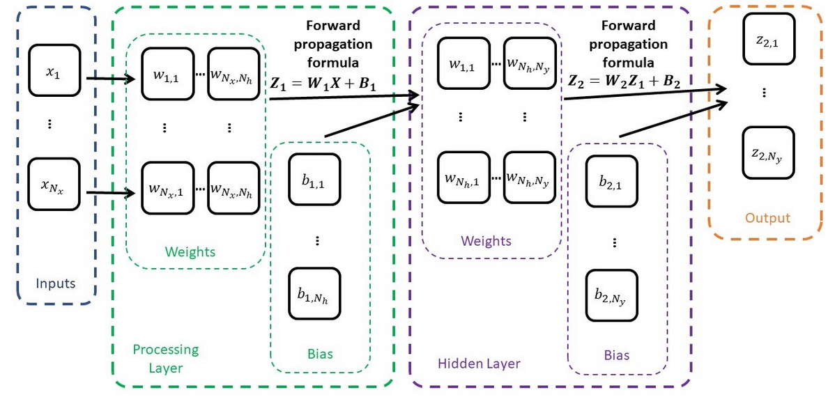
Our shallow NN with two processing layers

Slide 6
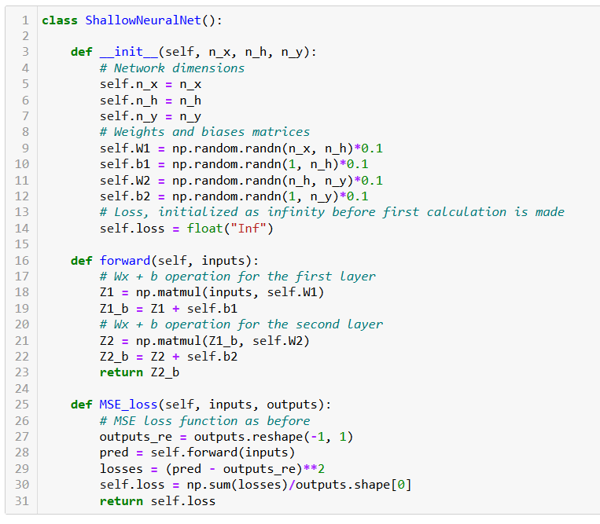
Our NN class
Changes:
Weights and biases are now initialized as normal random with zero mean and variance 1.
Forward method for making predictions using current parameters.
Loss function for performance evaluation.

Slide 7
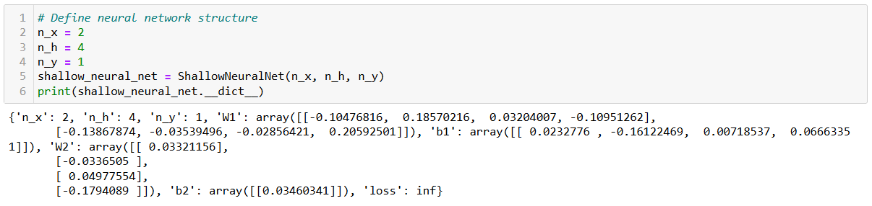
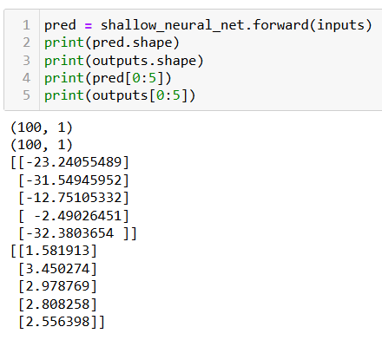
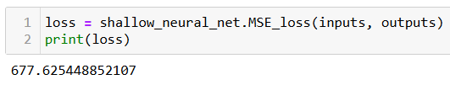
Initialize model
Forward to predict
Compute loss to evaluate model (it is bad, because trainable parameters have received random values!)

Slide 8
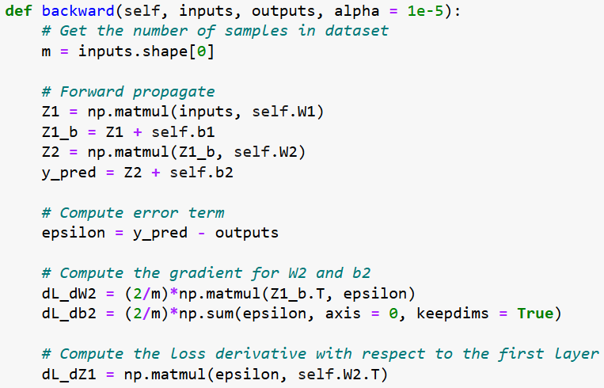
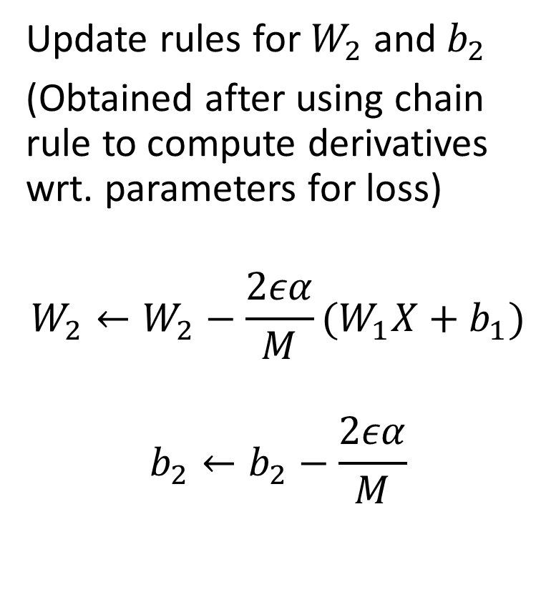
Backpropagation in our model
Update rules for $W_{2}$and $b_{2}$
(Obtained after using chain rule to compute derivatives wrt. parameters for loss)
$$W_{2}←W_{2}−\frac{2εα}{M}(W_{1}X+b_{1})$$
$$b_{2}←b_{2}−\frac{2εα}{M}$$

Slide 9
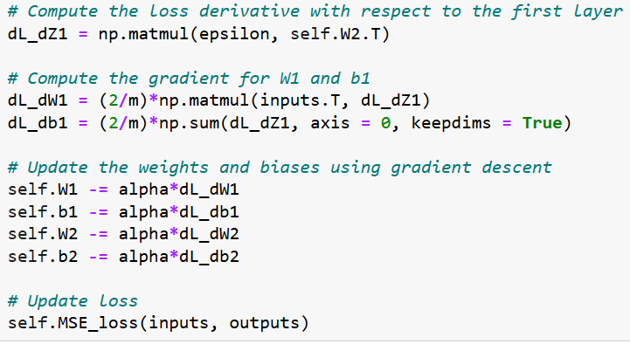
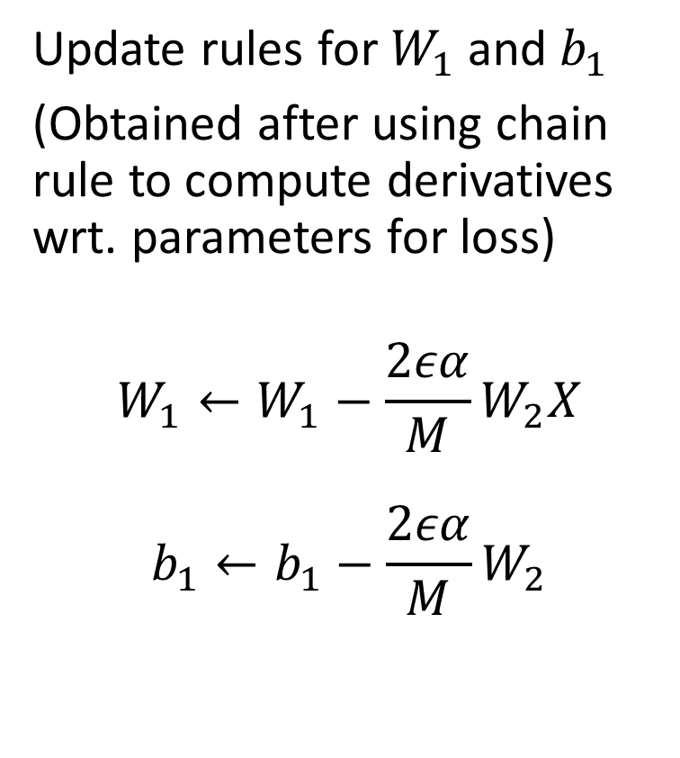
Backpropagation in our model
Update rules for $W_{1}$and $b_{1}$
(Obtained after using chain rule to compute derivatives wrt. parameters for loss)
$$W_{1}←W_{1}−\frac{2εα}{M}W_{2}X$$
$$b_{1}←b_{1}−\frac{2εα}{M}W_{2}$$

Slide 10
Training procedure, in short.
Forward pass on dataset samples
Compute errors and loss function
Use new loss value to compute gradients
Adjust parameters with backprop
Repeat until convergence or max number of iterations

Slide 11
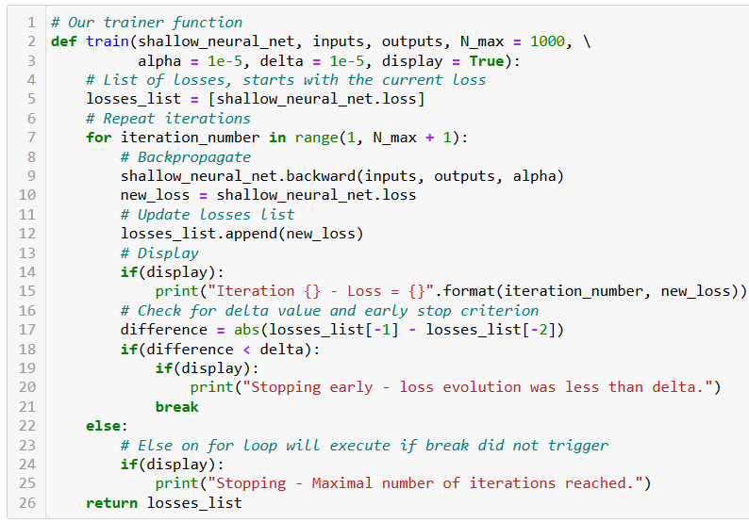
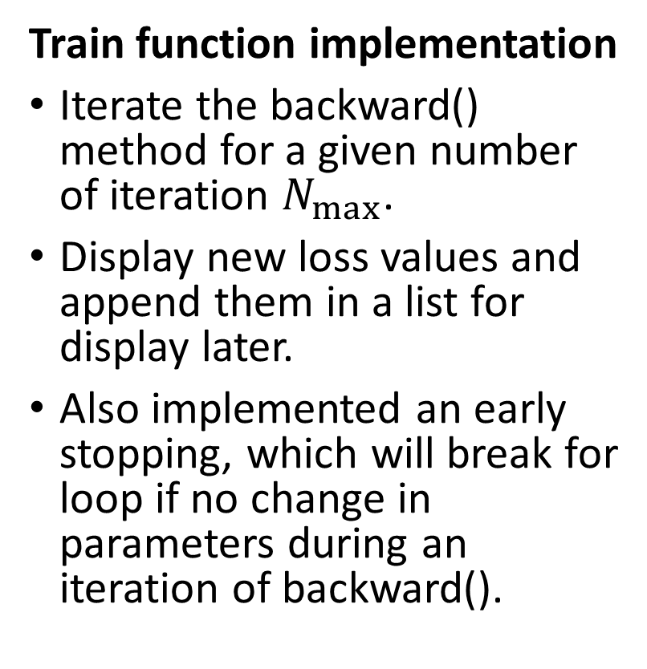
Trainer function for our model
Train function implementation
Iterate the backward() method for a given number of iteration $N_{max}$.
Display new loss values and append them in a list for display later.
Also implemented an early stopping, which will break for loop if no change in parameters during an iteration of backward().

Slide 12
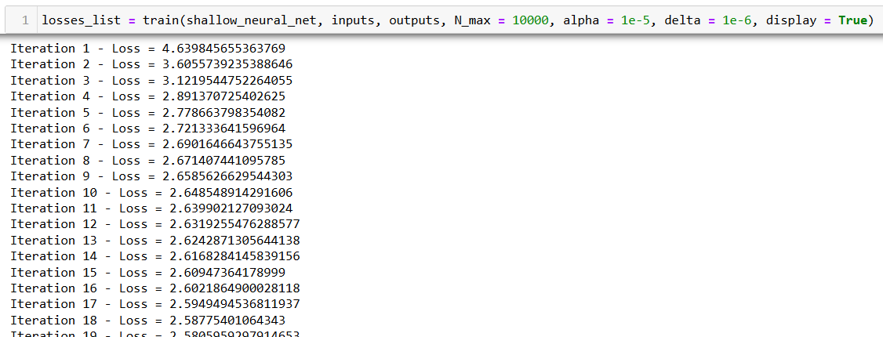
Trainer function for our model

Slide 13
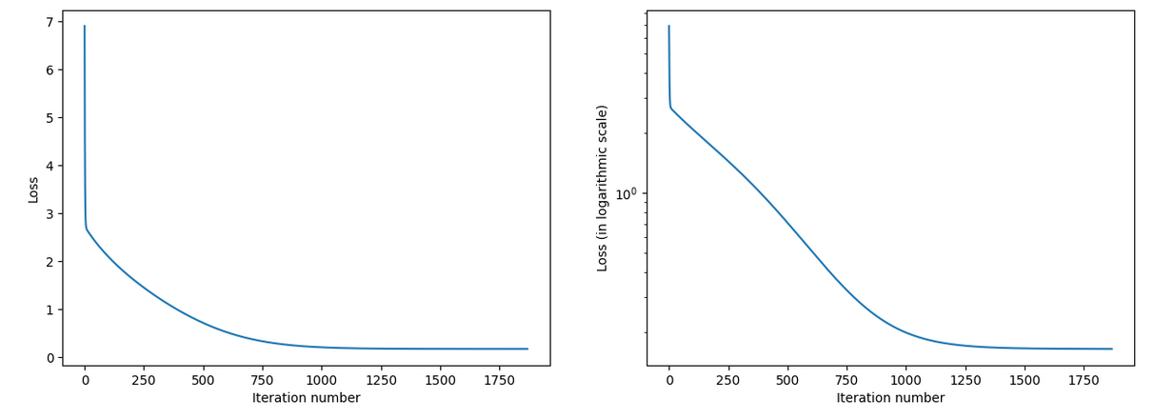
Trainer function for our model
The curves below are called performance/training curves and show how the training went.

Slide 14
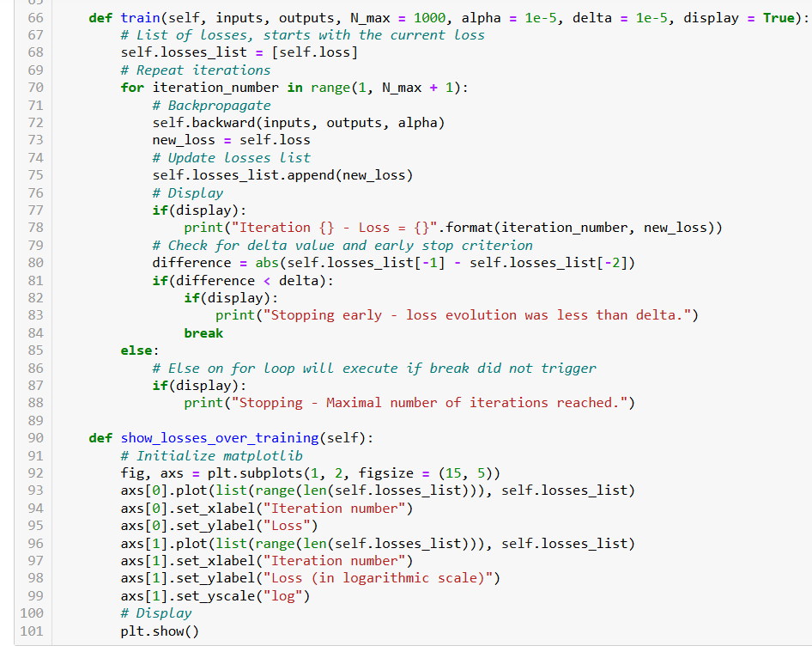
Finally, adding the trainer function and the performance curves function as methods to our class.

Slide 15
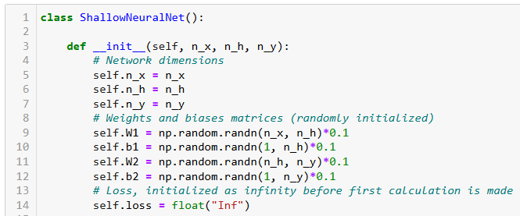
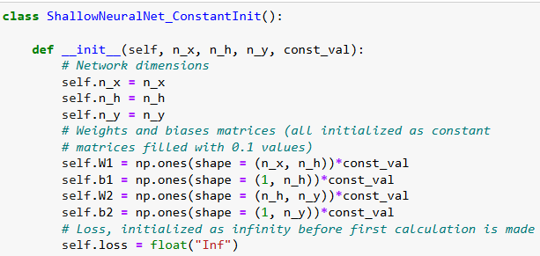
A bad initialization
In our previous version of the model, we initialized our parameters randomly.
While it seemed unimportant, this is actually essential.
Initializing parameters as constants would in fact be a terrible idea.
But we have to try it at least once to understand why.

Slide 16
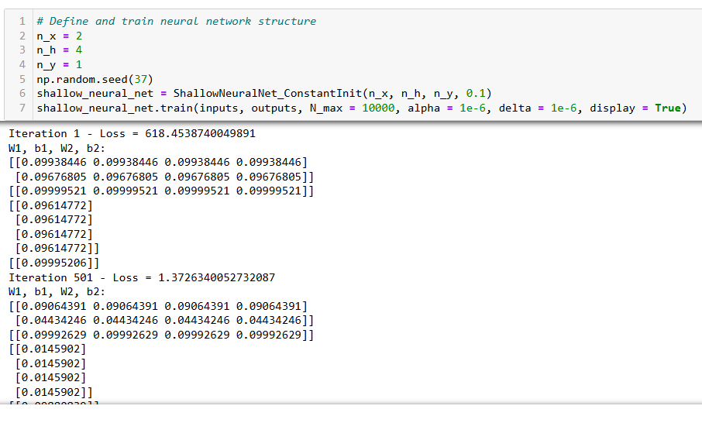
Training the constant initialization model

Slide 17
Training the constant initialization model
Same values on all groups of weights

Slide 18
Training the constant initialization model
Same values on all groups of weights
Same thing for bias vector

Slide 19
Training the constant initialization model
Same values on all groups of weights
Same thing for bias vector
Keeps happening without discontinuity no matter the number of iterations…
This means all neurons are doing the same thing!
(a.k.a. symmetry in the neural network)

Slide 20
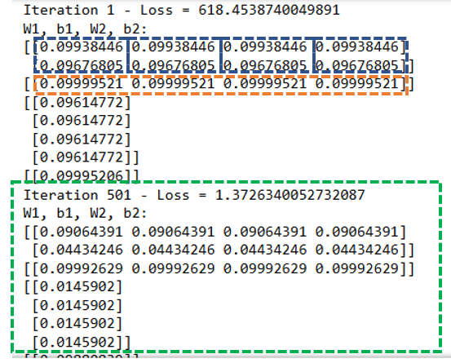
Symmetry in the Neural Network
Definition (Symmetry in the Neural Network):
Symmetry in a neural network is the tendency of all neurons to have the same weights and processes.
As a lack of diversity, this can lead to a lack of generalization and can prevent the NN from learning.
Additionally, symmetrical neural networks can be vulnerable to adversarial attacks (on Week 6).

Slide 21
Symmetry in the Neural Network
Definition (Symmetry in the Neural Network):
Symmetry in a neural network is the tendency of all neurons to have the same weights and processes.
As a lack of diversity, this can lead to a lack of generalization and can prevent the NN from learning.
Additionally, symmetrical neural networks can be vulnerable to adversarial attacks (on Week 6).
Essentially, this happened because all weights and biases had the same starting point (due to the constant initialization).
The backward process then updates the parameters identically, which is why they will end up keeping the same values over the course of training.
Need to enforce diversity on these parameters from the start! Hence, random initialization.

Slide 22
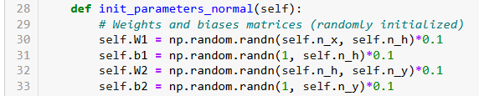
The random normal initialization
Definition (the random normal initialization [LeCun1998]):
The normal random initializer will setup parameters randomly, by sampling from a normal distribution, with a mean 0 and a standard deviation of 1 (or lower).
This initializer is straightforward and simple, but can lead to slow convergence or even divergence as the network gets deeper.

Slide 23
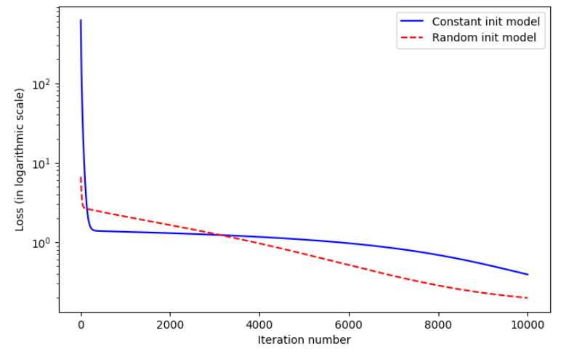
Using a random initialization is just better

Slide 24
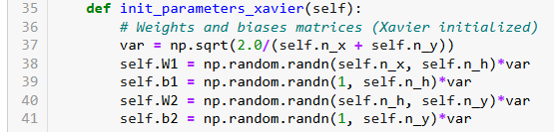
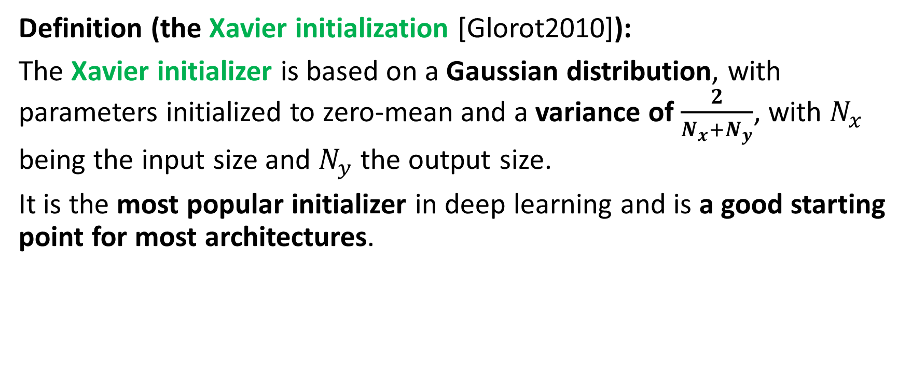
The Xavier initialization
Definition (the Xavier initialization [Glorot2010]):
The Xavier initializer is based on a Gaussian distribution, with parameters initialized to zero-mean and a variance of $\frac{2}{N_{x}+N_{y}}$, with $N_{x}$ being the input size and $N_{y}$ the output size.
It is the most popular initializer in deep learning and is a good starting point for most architectures.

Slide 25
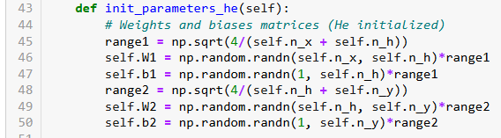
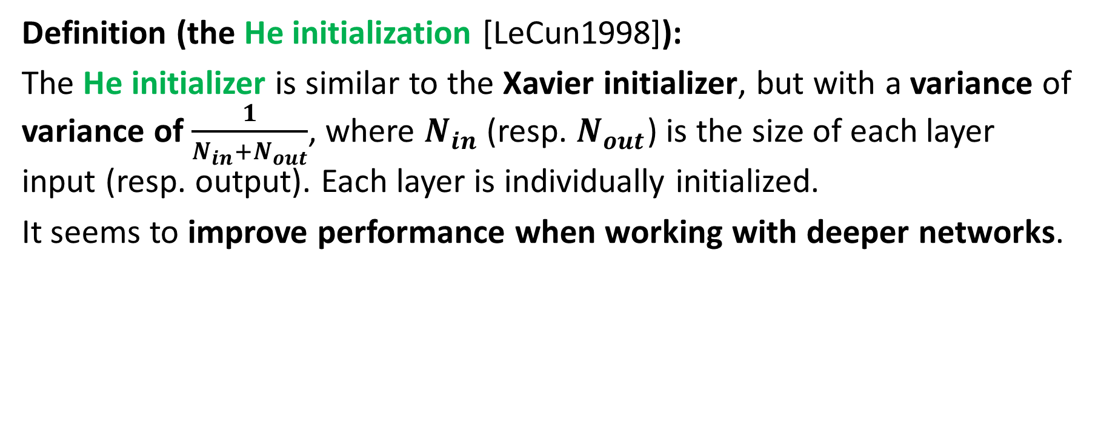
The He initialization
Definition (the He initialization [LeCun1998]):
The He initializer is similar to the Xavier initializer, but with a variance of variance of $\frac{1}{N_{in}+N_{out}}$, where $N_{in}$ (resp. $N_{out}$) is the size of each layer input (resp. output). Each layer is individually initialized.
It seems to improve performance when working with deeper networks.

Slide 26
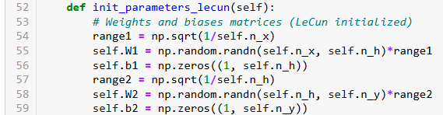
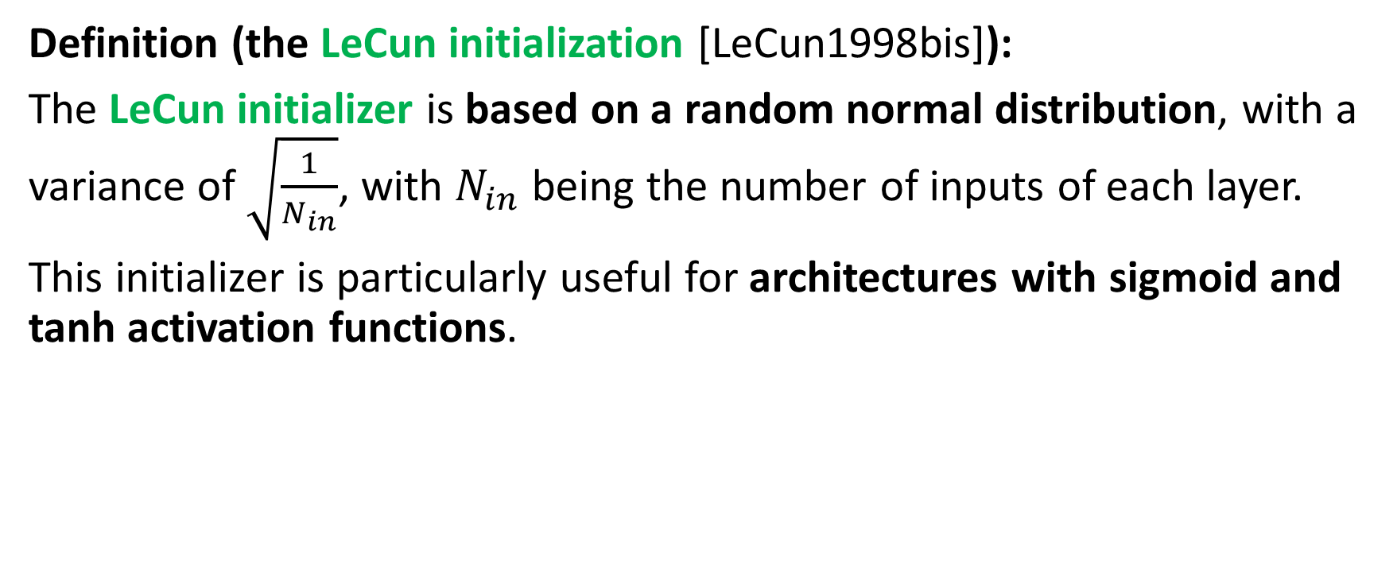
The LeCun initialization
Definition (the LeCun initialization [LeCun1998bis]):
The LeCun initializer is based on a random normal distribution, with a variance of $\sqrt{\frac{1}{N_{in}}}$, with $N_{in}$ being the number of inputs of each layer.
This initializer is particularly useful for architectures with sigmoid and tanh activation functions.

Slide 27
Initializations variations and more
Many more initialization formulas exist:
Xavier has random uniform and normal variations (same for He),
Glorot proposed more initializations (e.g. the Glorot uniform initialization),
Orthogonal initializations are sometimes useful also but rare,
Variance scaling initialization also exists but rarely used, etc.
PyTorch has listed a lot of them, ready to use: https://pytorch.org/docs/stable/nn.init.html

Slide 28
No free lunch theorem
What I listed earlier are empirical observations only, not absolute rules.
For this reason, it is a good idea to try a few different initialization techniques and see which one works best for your particular network architecture and dataset.
Some recent research has also suggested that using a combination of different initialization techniques (e.g., Xavier initialization for some layers and He initialization for others) can improve performance.
Also, careful: Every now and then, we get a “smart*ss” claiming to have found a “ground-breaking new initializer beating all others”.
In reality, there is something that the machine learning community likes to call the “No free lunch theorem“.

Slide 29
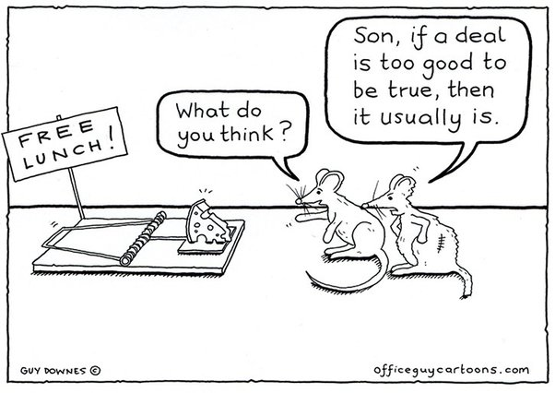
No free lunch theorem
Definition (the no free lunch (or NFL) theorem):
The no free lunch (NFL) theorem for supervised machine learning is a theorem that essentially implies that no single machine learning algorithm or tool is universally the best-performing algorithm for all problems.
(https://en.wikipedia.org/wiki/No_free_lunch_theorem).
When in doubt about a supposedly “ground-breaking new technique beating all other techniques”, try them out.

Slide 30
No free lunch theorem – season 1
Definition (the no free lunch (or NFL) theorem – season 1):
The no free lunch (NFL) theorem also implies that there is no such thing “one initializer that works for all models and problems”.
No choice: try some of them and see how it goes!
When in doubt about a supposedly “ground-breaking new technique beating all other techniques”, try them out.

Slide 31
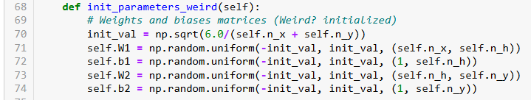
A weird initializer
Definition (our custom “weird” initializer):
Let us consider the “weird” initializer below. It uses a random uniform distribution, scaling parameters based on the input and output sizes, like in Xavier/He. We could in fact see this as a random uniform variation of Xavier/He.
And yet, when we use it, something weird happens.

Slide 32
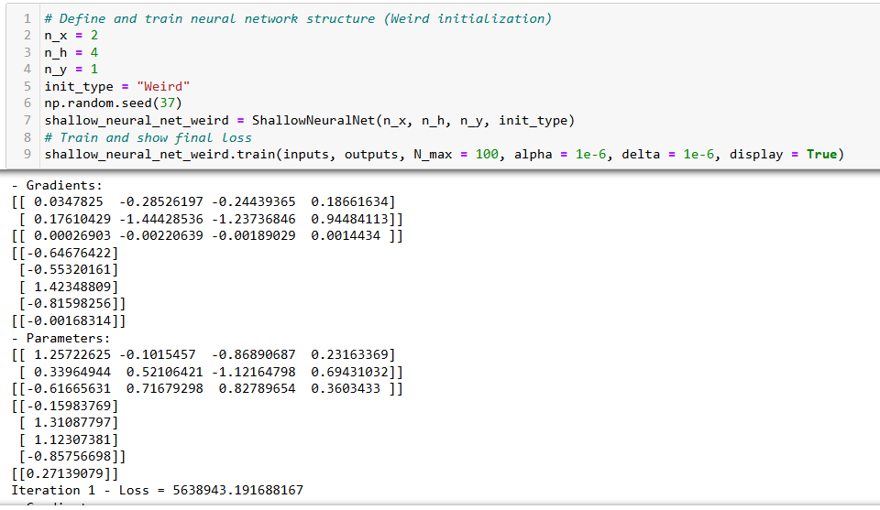
Wow, that’s a big loss value!?

Slide 33
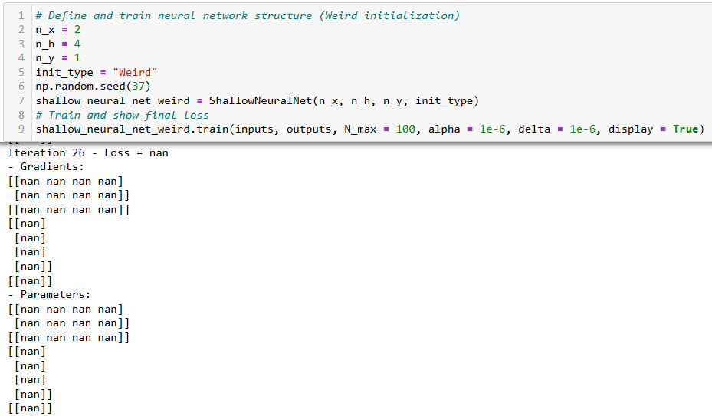
And after iteration 26, we are getting NaNs (Not a Number values) all over the place…?!
What is going on…?!

Slide 34
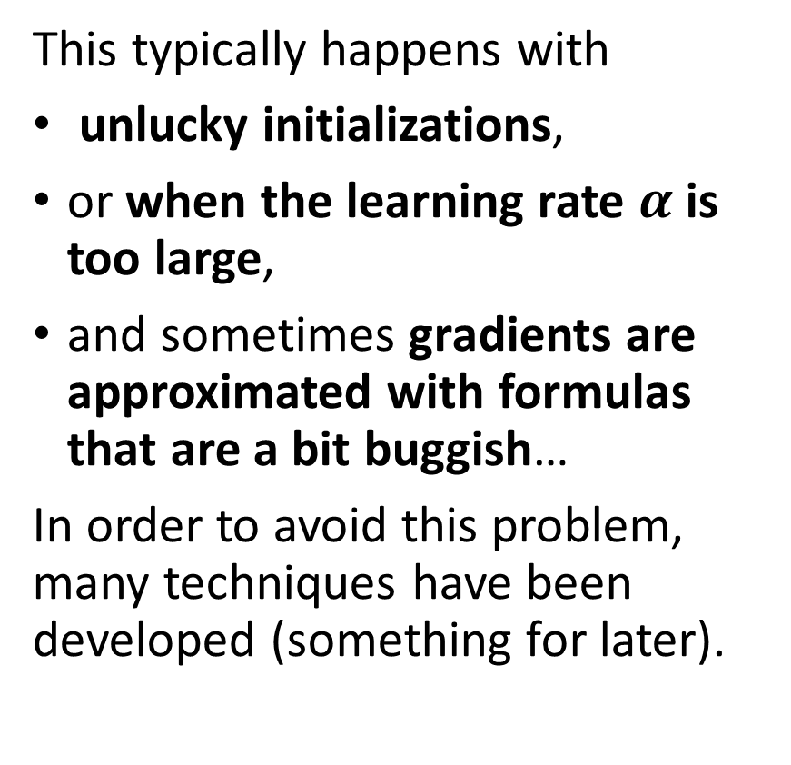
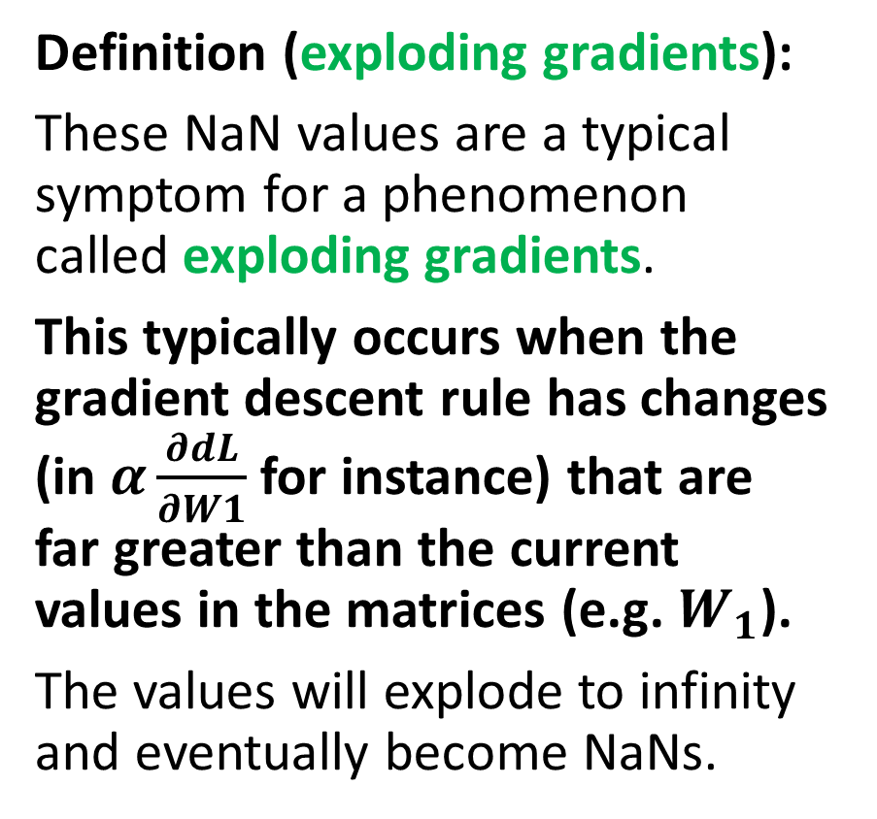
The exploding gradient problem
Definition (exploding gradients):
These NaN values are a typical symptom for a phenomenon called exploding gradients.
This typically occurs when the gradient descent rule has changes (in $α\frac{∂dL}{∂W1}$for instance) that are far greater than the current values in the matrices (e.g. $W_{1}$).
The values will explode to infinity and eventually become NaNs.
This typically happens with
unlucky initializations,
or when the learning rate $α$ is too large,
and sometimes gradients are approximated with formulas that are a bit buggish…
In order to avoid this problem, many techniques have been developed (something for later).

Slide 35
Unlucky initialization
Definition (Unlucky Initialization):
Unlucky Initialization is the term used to describe when a system's behaviour is impossible to predict due to the randomness of its initial conditions.
In some cases, the output of a system will be drastically different depending on the initial conditions, which can lead to vastly different outcomes.
In our previous “weird” initializer, we can resolve the NaN problem, by just using a different seed for the initialization…!
Yup, as simple as that!
BTW, that could be a proof that the NFL theorem is indeed true!

Slide 36
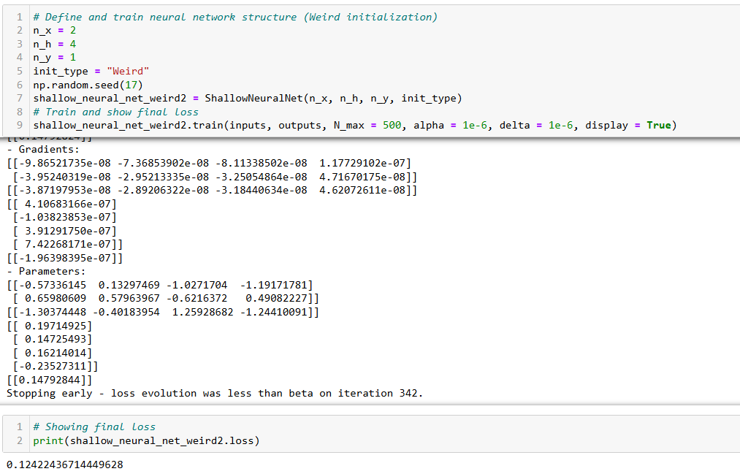
Different seed…
Now that works?!

Slide 37
The learning rate tradeoff
Definition (Learning rate tradeoff):
The learning rate is a hyperparameter which controls the step size taken by the algorithm in order to minimize the loss function during training.
If the learning rate is too small, the algorithm will take longer to converge, but it can also prevent overshooting the global minimum.
If the learning rate is too high, the algorithm may converge faster, but it may lead to exploding gradients.
There is therefore a tradeoff on the deep learning rate, and as in all things with tradeoffs, it is about finding the optimal middle ground.
High Learning rate value:
Trains faster
Risk of overshooting min
Risk of exploding gradient
Low learning value:
Trains slow, but safe
Risk of training so slow we barely make any changes

Slide 38
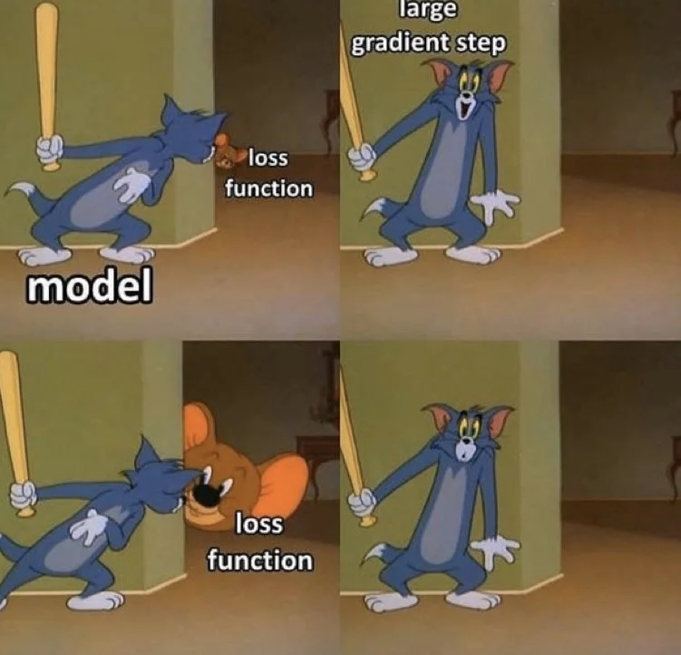
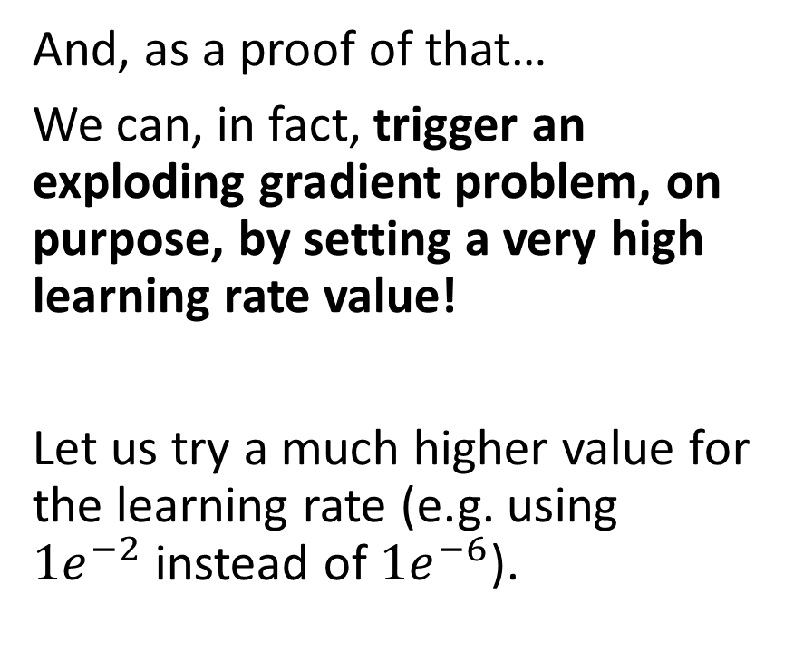
Triggering an exploding gradient on purpose
And, as a proof of that…
We can, in fact, trigger an exploding gradient problem, on purpose, by setting a very high learning rate value!
Let us try a much higher value for the learning rate (e.g. using $1e^{−2}$instead of $1e^{−6}$).

Slide 39
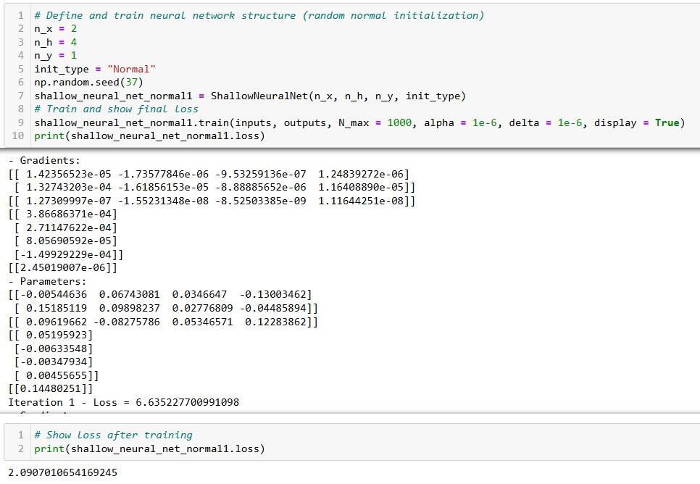
Normal initialization and low learning rate (1e-6)
This is fine…

Slide 40
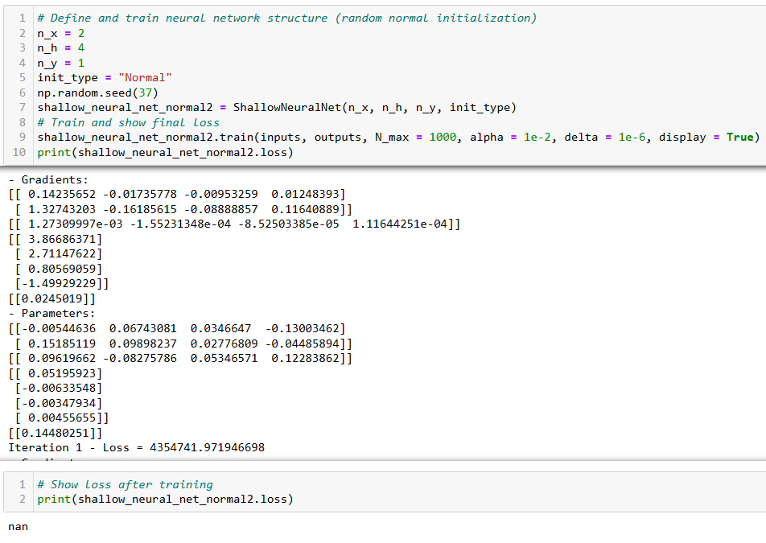
Learning rate too high leads to exploding gradients

Slide 41

No free lunch theorem – season 2
Definition (the no free lunch (or NFL) theorem – season 2):
The no free lunch (NFL) theorem also implies that there is no “one value that works for all models” for hyperparameters such as the learning rate.
No choice: try some values and see how it goes!

Slide 42
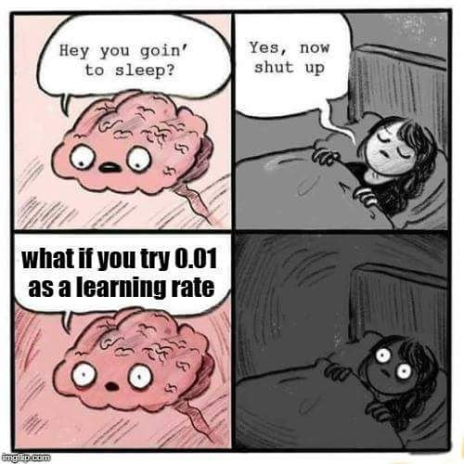
The learning rate tradeoff
Definition (Hyperparameter tuning):
As we have seen, the learning rate is a hyperparameter that needs to be carefully chosen.
Thus, an important part of deep learning is hyperparameter tuning.
It consists, for instance, of finding the optimal learning rate that will allow the algorithm to converge quickly and reliably.
Note: sometimes, that is what makes the difference between a model that successfully trains and a model that does not!

Slide 43
Controlling gradients to prevent explosions
Adjusting and trying different values for the learning rate is often good enough to prevent exploding gradients.
There are other options, like:
Downscaling initial values: divide initial parameter values by a certain factor.
Gradient clipping: set a max value for change on a single iteration and truncate any change that goes above that (to be discussed later).
Time evolution on learning rate: make the learning rate value change over time (to be discussed later).

Slide 44
Back to our first exploding gradient example

Slide 45
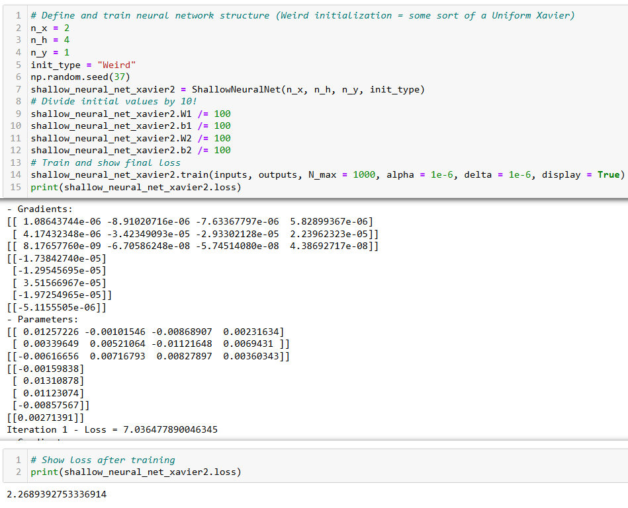
Downscaling parameters after initialization worked, but it leads to slower training.

Slide 46
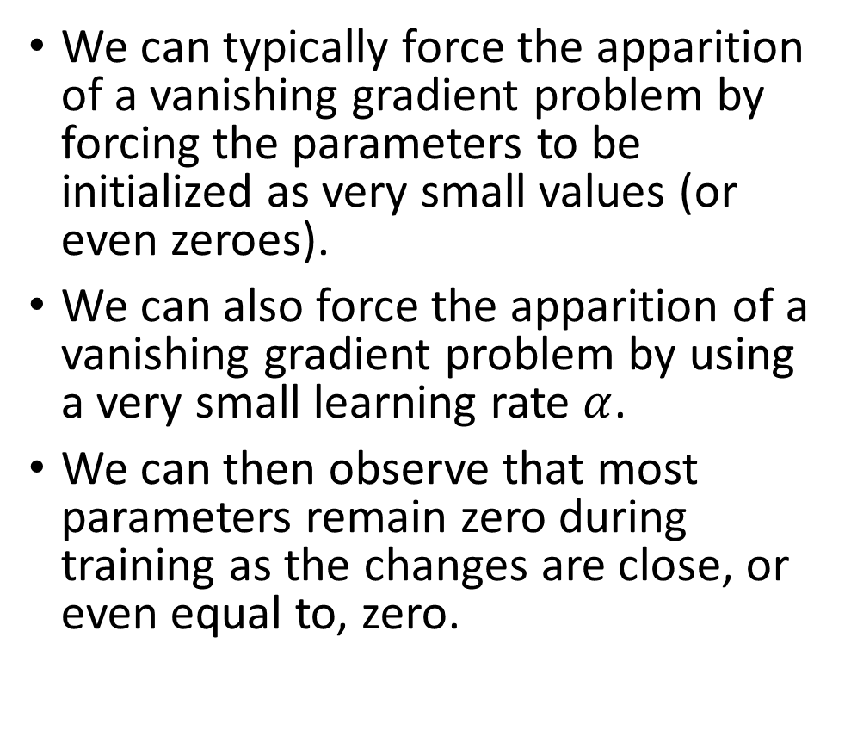
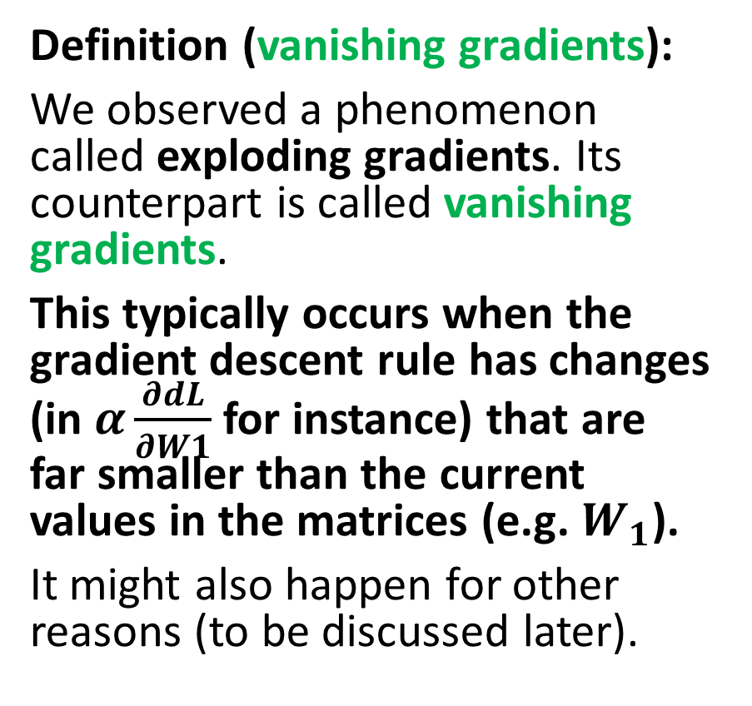
The vanishing gradient problem
Definition (vanishing gradients):
We observed a phenomenon called exploding gradients. Its counterpart is called vanishing gradients.
This typically occurs when the gradient descent rule has changes (in $α\frac{∂dL}{∂W1}$for instance) that are far smaller than the current values in the matrices (e.g. $W_{1}$).
It might also happen for other reasons (to be discussed later).
We can typically force the apparition of a vanishing gradient problem by forcing the parameters to be initialized as very small values (or even zeroes).
We can also force the apparition of a vanishing gradient problem by using a very small learning rate $α$.
We can then observe that most parameters remain zero during training as the changes are close, or even equal to, zero.

Slide 47
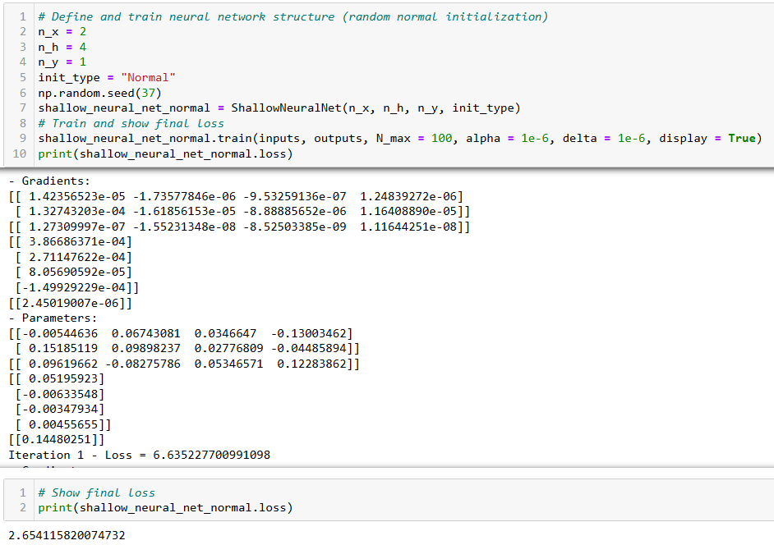
This is fine

Slide 48
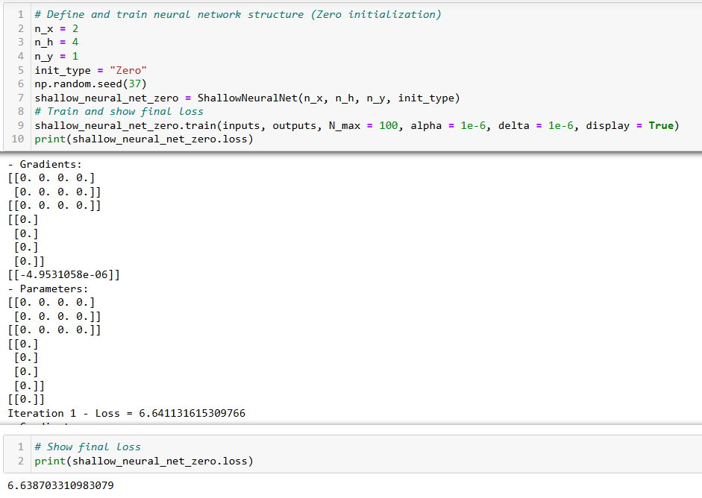
Initializing parameters as zeroes is seriously problematic and the model just does not train

Slide 49
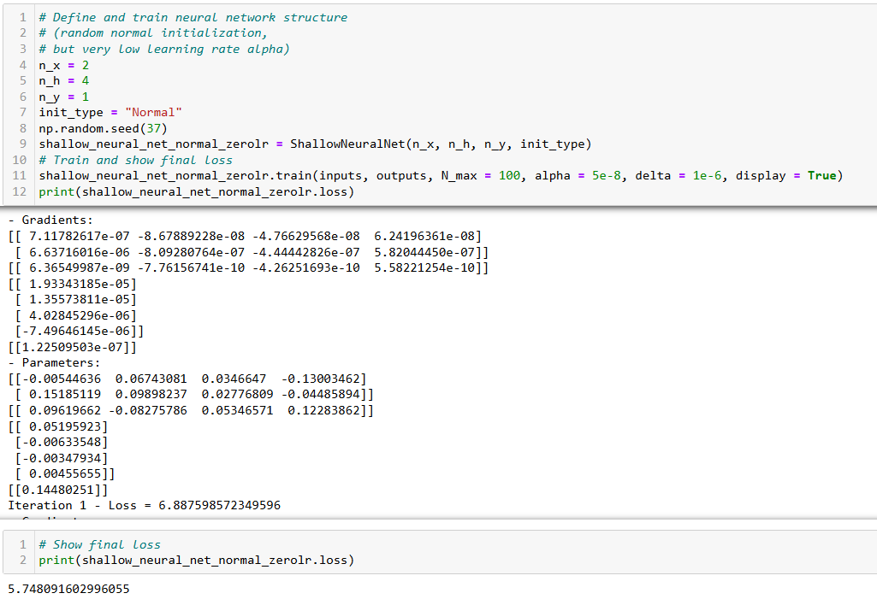
Setting up a learning rate that is too small might seriously hinder the training.
And sometimes even lead to a “convergence” to wrong minimum.

Slide 50
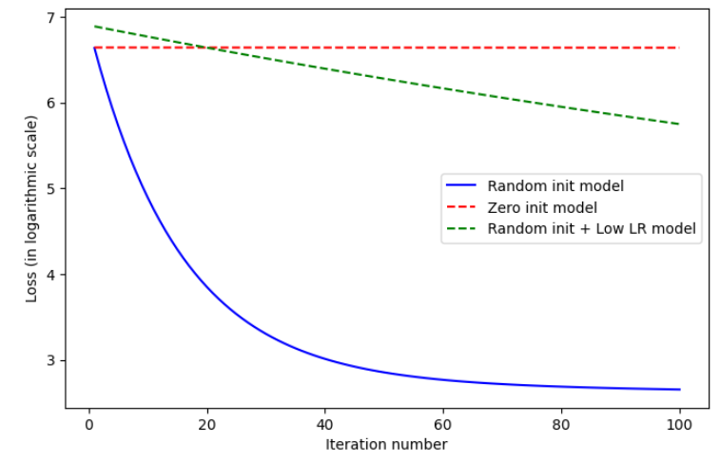

Slide 51
Remember, the learning rate tradeoff
Definition (Hyperparameter tuning):
As we have seen, the learning rate is a hyperparameter that needs to be carefully chosen.
Thus, an important part of deep learning is hyperparameter tuning.
It consists, for instance, of finding the optimal learning rate that will allow the algorithm to converge quickly and reliably.
Note: sometimes, that is what makes the difference between a model that successfully trains and a model that does not!

Slide 52
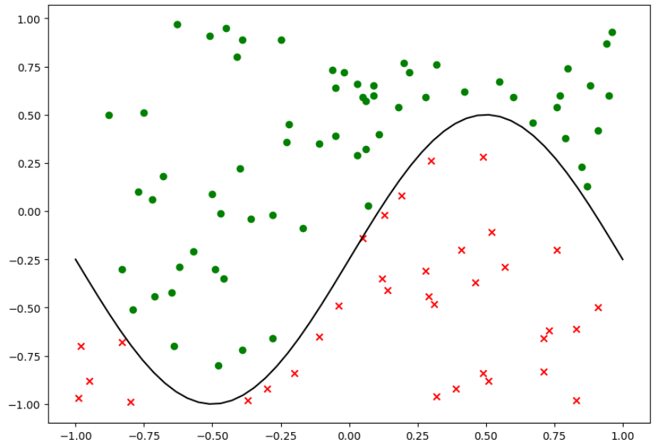
New dataset!

Slide 53
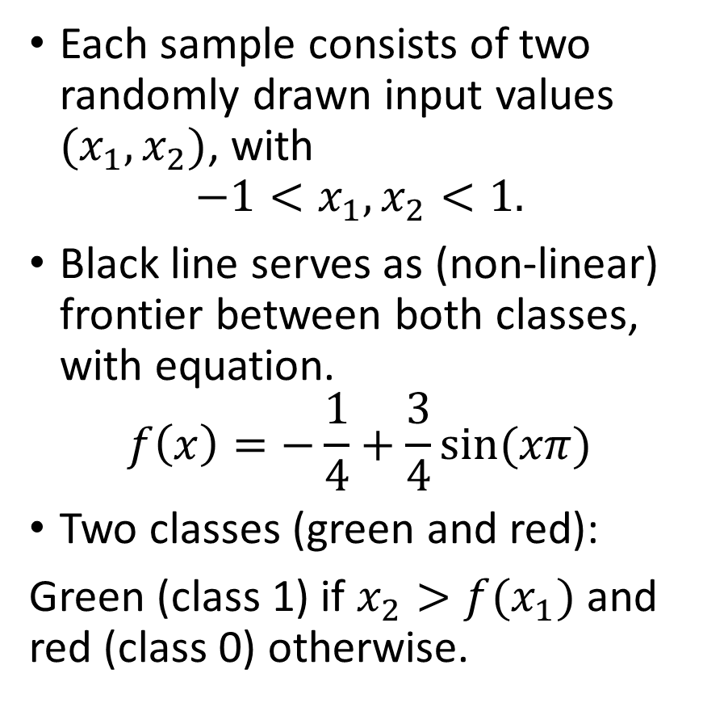
New dataset!
Each sample consists of two randomly drawn input values $(x_{1}, x_{2})$, with
$$−1<x_{1}, x_{2}<1.$$
Black line serves as (non-linear) frontier between both classes, with equation.
$$f\left(x\right)=−\frac{1}{4}+\frac{3}{4}sin⁡(xπ)$$
Two classes (green and red):
Green (class 1) if $x_{2}>f(x_{1})$ and red (class 0) otherwise.

Slide 54
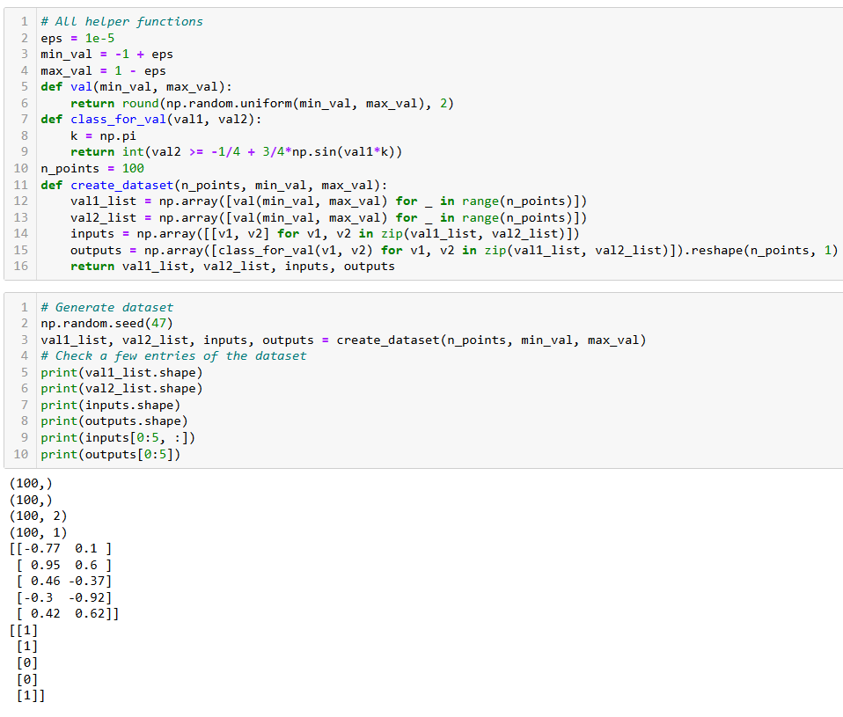
New dataset!
We can generate some entries using the helper functions here.
Basically drawing pairs of values randomly and checking if above or below the sine line.

Slide 55
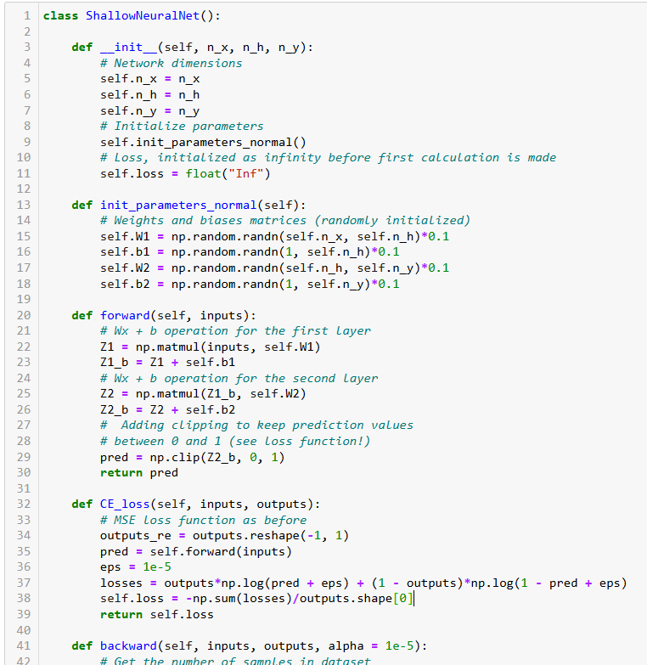
Adjusting our shallow NN
We can adjust our shallow neural network to the task by:
Using the same two layers and forward pass procedure as before, leaving our init and forward methods untouched.
Replace MSE with our cross-entropy (another name for the log-likelihood loss).
Backward and trainer methods untouched.

Slide 56
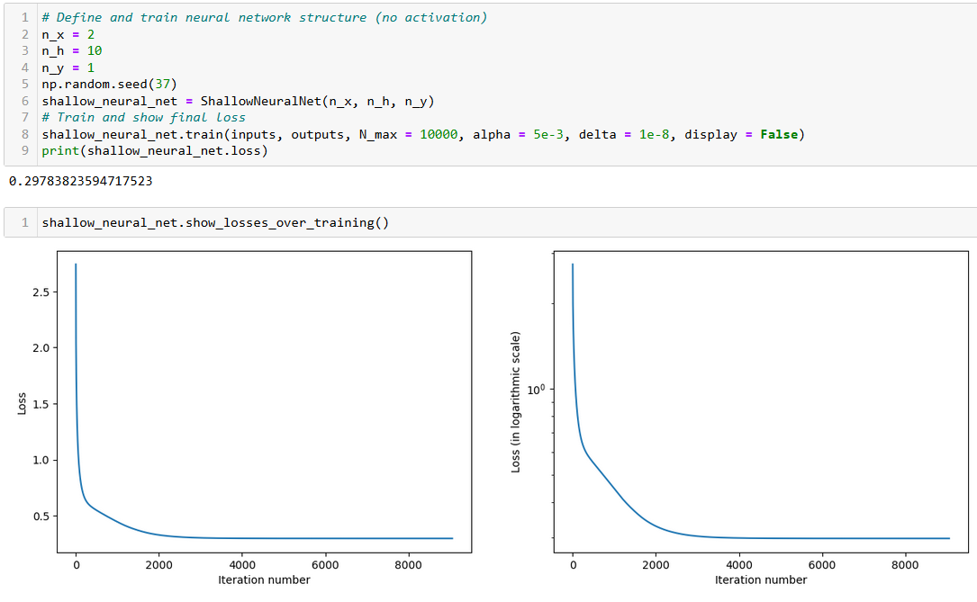
Trains just fine! (or does it?)

Slide 57

Trains just fine! (or does it?)
NOPE

Slide 58


Linear layers necessarily lead to linear boundary
Our model consists of two linear layers, with two WX+B operations in a row.
The final result is necessarily linear also, as shown in the final $y_{pred}$ equation.
Boundary is therefore linear!

Slide 59
Trains just fine! (or does it?)
Well that is going to be a problem, because the black frontier is definitely not linear…
Or, in other words, the data is not linearly separable.

Slide 60
Activation functions and introducing non-linearity in the Neural Networks
Definition (Activation functions and non-linearity):
Activation functions are an important component of neural networks because they introduce non-linearity to the model.
This is important because most real-world data is non-linear.
Simply done by adding an extra operation after the linear one, for instance our sigmoid function.
Layer input X
Linear operation Z = WX+B
Linear operation output Z
Activation function A = s(Z)
Layer output A
Our new layer prototype, to be used in place of the Linear operation only

Slide 61

Adding sigmoid activations
We can update our model by:
Adding a sigmoid method, implementing the sigmoid operation from earlier.
Adding sigmoid operations after each linear operation in the forward method.
Our cross-entropy loss method remains unchanged, as it will simply use the updated forward procedure.

Slide 62
Adding sigmoid activations
Careful now…
As the forward procedure has changed, we have to update the backward propagation.
Going back to the chain rule procedure and accounting for the new sigmoid operations gives us the new update rules to use in the backward method…

Slide 63
Drawing a computation graph
Inputs $X$
Inputs 𝑋
Linear #1 $$Z_{1}= W_{1}X + b_{1}$$
Linear #1 Z_1= 𝑊_1 𝑋 + 𝑏_1
Sigmoid
$$A_{1} = s(Z_{1})$$
Sigmoid
𝐴_1 = 𝑠(𝑍_1)
Linear #2 $$Z_{2}= W_{2}X + b_{2}$$
Linear #2 Z_2= 𝑊_2 𝑋 + 𝑏_2
Sigmoid
$$A_{2} = s(Z_{2})$$
Sigmoid
𝐴_2 = 𝑠(𝑍_2)
Cross Entropy Loss $L(A_{2}, Y)$
Cross Entropy Loss 𝐿(𝐴_2, 𝑌)

Slide 64

Drawing a computation graph
Our forward method gives:
$$Z_{1} = W_{1}X + b_{1}$$
$$A_{1} = s(Z_{1})$$
$$Z_{2} = W_{2}A_{1} + b_{2}$$
$$A_{2} = s(Z_{2})$$
$$L =\frac{−1}{N} \sum_{i}^{N}{Y\ln\left(A_{2}\right)+\left(1−Y\right)ln(}1−A_{2})$$

Slide 65

Drawing a computation graph
Retrieving the gradient descent update rules takes a few steps and requires some organizing…
First, recall that our loss function is defined as
$$L =\frac{−1}{N} \sum_{i}^{N}{Y\ln\left(A_{2}\right)+\left(1−Y\right)ln(}1−A_{2})$$
Therefore, we have
$$\frac{∂L}{∂A_{2}}=−\frac{Y}{A_{2}}+\frac{1−Y}{1−A_{2}}$$

Slide 66

Drawing a computation graph
Then, recall that
$$A_{2} = s(Z_{2})$$
We can then prove that
$$s′\left(X\right)=s\left(X\right)\left(1−s\left(X\right)\right)$$
Using the chain rule, we then obtain
$$\frac{∂L}{∂Z_{2}}=\frac{∂L}{∂A_{2}}\frac{∂A_{2}}{∂Z_{2}}=\frac{∂L}{∂A_{2}}A_{2}(1−A_{2})$$

Slide 67

Drawing a computation graph
Let us continue going backwards
$$Z_{2} = W_{2}A_{1} + b_{2}$$
Using the chain rule, we then obtain
$$\frac{∂L}{∂W_{2}}=\frac{∂L}{∂Z_{2}}\frac{∂Z_{2}}{∂W_{2}}=\frac{∂L}{∂Z_{2}}A_{1}$$
$$\frac{∂L}{∂b_{2}}=\frac{∂L}{∂Z_{2}}\frac{∂Z_{2}}{∂b_{2}}=\frac{∂L}{∂Z_{2}}$$

Slide 68

Drawing a computation graph
Let us continue going backwards
$$Z_{2} = W_{2}A_{1} + b_{2}$$
$$A_{1} = s(Z_{1})$$
Using the chain rule and our sigmoid derivative, we then obtain
$$\frac{∂L}{∂A_{1}}=\frac{∂L}{∂Z_{2}}\frac{∂Z_{2}}{∂A_{1}}=\frac{∂L}{∂Z_{2}}W_{2}$$
$$\frac{∂L}{∂Z_{1}}=\frac{∂L}{∂A_{1}}\frac{∂A_{1}}{∂Z_{1}}=\frac{∂L}{∂A_{1}}A_{1}(1−A_{1})$$

Slide 69
Drawing a computation graph
Let us continue going backwards
$$Z_{2} = W_{2}A_{1} + b_{2}$$
$$A_{1} = s(Z_{1})$$
Using the chain rule and our sigmoid derivative, we then obtain
$$\frac{∂L}{∂A_{1}}=\frac{∂L}{∂Z_{2}}\frac{∂Z_{2}}{∂A_{1}}=\frac{∂L}{∂Z_{2}}W_{2}$$
$$\frac{∂L}{∂Z_{1}}=\frac{∂L}{∂A_{1}}\frac{∂A_{1}}{∂Z_{1}}=\frac{∂L}{∂A_{1}}A_{1}(1−A_{1})$$

Slide 70

Drawing a computation graph
Let us continue going backwards
$$Z_{1} = W_{1}X+ b_{1}$$
Using the chain rule and our sigmoid derivative, we then obtain
$$\frac{∂L}{∂W_{1}}=\frac{∂L}{∂Z_{1}}\frac{∂Z_{1}}{∂W_{1}}=\frac{∂L}{∂Z_{1}}X$$
$$\frac{∂L}{∂b_{1}}=\frac{∂L}{∂Z_{1}}\frac{∂Z_{1}}{∂b_{1}}=\frac{∂L}{∂Z_{1}}$$

Slide 71

Adding sigmoid activations
Reusing our formulas carefully gives the following update for the backward method.
Notice how we do not rush and compute each term, one operation at a time, to avoid making mistakes.

Slide 72

Trains just fine!

Slide 73

Trains just fine!
Using the sigmoid activation functions helped the network create some non-linearity!
(Looks great!)

Slide 74



Examples of activations: sigmoid
Definition (sigmoid function):
$$s\left(x\right)=\frac{1}{1+exp⁡(−x)}$$
The sigmoid activation function is often used in the output layer of a binary classification model, because the output will then have values between 0 and 1, and can therefore be interpreted as a probability.

Slide 75


Examples of activations: Hyperbolic tangent
Definition (tanh function):
The tanh (short for "hyperbolic tangent") activation function is similar to the sigmoid function, but it maps values to a range between -1 and 1.
Like the sigmoid function, it is often used in the output layer of a classification model.

Slide 76


Examples of activations: ReLU
Definition (ReLU function):
The ReLU (short for "rectified linear unit") activation function is a simple function that maps any input value less than 0 to 0, and any input value greater than or equal to 0 to the input value itself.
It is widely used because it is computationally efficient and does not saturate (i.e., "die") like some other activation functions.

Slide 77


Examples of activations: Leaky ReLU
Definition (Leaky ReLU function):
The leaky ReLU activation function is similar to the ReLU function, but it allows a small negative slope for input values less than 0.
This can help to alleviate the "dying ReLU" problem, where some neurons in the network "die" and no longer respond to input.

Slide 78


Examples of activations: ELU
Definition (ELU function):
The ELU (short for "exponential linear unit") activation function is similar to the ReLU function, but it has a negative slope for input values less than 0.
Like the leaky ReLU function, it can help to alleviate the "dying ReLU" problem.

Slide 79

A note on activation functions
We have listed the most common activation functions, which are used 99% of the time.
Keep in mind that many more activation functions exist, some of them being very niche, but worth keeping an eye on. Have a look at the list here: https://pytorch.org/docs/stable/nn.html#non-linear-activations-weighted-sum-nonlinearity

Slide 80

The universal approximation theorem
Definition (the Universal Approximation Theorem):
Mathematically speaking, any neural network architecture aims at finding the mathematical function $y= f(x)$that can map some given inputs ($x$) to outputs ($y$). And the function $f(x)$ can be arbitrarily complex, based on the dataset and task at hand.
The Universal Approximation Theorem tells us that Neural Networks have a kind of universality property.
This means that no matter what $f(x)$might be, there is a network that can approximately approach the function $f\left(x\right)$!
As such, this is the most important theorem of Deep Learning!

Slide 81

The problem with gradient descent algorithm
Let us consider the following function:
$$f\left(x\right)=\frac{319}{8400} x^{4} +\frac{43}{4200}x^{3} −\frac{6799}{8400} x^{2} −\frac{299}{840} x + 6$$
And let us assume we are trying to solve the optimization problem:
$$x^{∗}=\arg{\min_{x}{f(x)}}$$

Slide 82

The problem with gradient descent algorithm
The derivative of $f$ is:
$$f^{′}\left(x\right)=\frac{1276}{8400} x^{3}+\frac{129}{4200} x^{2} −\frac{13598}{8400} x −\frac{299}{840}$$
And we could use gradient descent to solve this optimization by using the following update rule:
$$x←x −αf′(x)$$

Slide 83



The problem with gradient descent algorithm
Our vanilla gradient descent algorithm is implemented by defining the objective function $f$ and its derivative $f′$.
We can then implement our vanilla gradient descent algorithm for this optimization problem as shown below.

Slide 84


The problem with gradient descent algorithm
The function $f$ admits a global minimum at $x≈3.27$ and a local (non-global) minimum at $x≈ −3.25$, as shown in the figure below.

Slide 86


The problem with gradient descent algorithm
When using $x_{0} = 5$as a starting point for our gradient descent, we do converge to the global minimum.

Slide 87


The problem with gradient descent algorithm
When using $x_{0} =−5$as a starting point for our gradient descent, however, we end up converging to the local (non-global) minimum.
Unfortunately, in the presence of local non-global minima, the GD algorithm might end up getting trapped and converging to the wrong value.

Slide 88

The problem with gradient descent algorithm
When using $x_{0} =−5$as a starting point for our gradient descent, however, we end up converging to the local (non-global) minimum.
Unfortunately, in the presence of local non-global minima, the GD algorithm might end up getting trapped and converging to the wrong value.
In the case of our Neural Networks:
this could lead to suboptimal parameters 𝑊 and 𝑏, which are not going to minimize the loss functions used for training,
and therefore lead to a Neural Network that has not been optimally trained for its task.

Slide 89


The problem with gradient descent algorithm
When the function is convex: gradient descent is guaranteed to converge to the global minimum, no matter the starting point.
When the function is not convex (and our function $f$ is not): the starting point has an impact and might lead to a completely different outcome.
Some solutions exist, but are not guaranteed to work.

Slide 90

Adding momentum to gradient descent
Definition (Gradient Descent with Added Momentum):
In an attempt to alleviate this phenomenon, we propose to use momentum.
It is a method that helps accelerate the training process by updating the weights of the model by reusing values from the past gradients.
The idea is that, if a direction in the parameters space consistently leads to good reduction in the loss function, then that direction should be reinforced.
Momentum can be implemented by adding a term to the parameter update, for instance:
$$x← x −α f′(x) +μ f_{prev}^{′}$$
As before,
$α$ is a hyperparameter that controls the step size/learning rate at each iteration,
And the coefficient $μ$is another hyperparameter that controls the influence of the momentum, or previous gradient update $f_{prev}^{′}$.

Slide 91


Adding momentum to gradient descent
Using momentum can help the model converge faster and can also help escape local minima and converge to global minima instead.
However, it can also cause the model to overshoot the global minimum and diverge, so – just like with the learning rate – it is important to tune the momentum hyperparameter $μ$ carefully (NFL theorem!).

Slide 92


Adding momentum to gradient descent
Definition (Gradient Descent with Added Momentum):
Momentum is a method that helps accelerate the training process by updating the weights of the model by reusing values from the past gradients.
Momentum can be implemented by adding a term to the parameter update, for instance:
$$x← x −α f′(x) +μ f_{prev}^{′}$$

Slide 93

Adding momentum to gradient descent
As before, if the starting point is good and not too much momentum is used, we will converge to the correct minimum.

Slide 94

Adding momentum to gradient descent
As before, if the starting point is bad and not too much momentum is used, we will end up converging to the incorrect minimum, like before.

Slide 95

Adding momentum to gradient descent
However, if the starting point is bad and enough momentum is used, we might be able to escape the local minimum and end up converging to the correct minimum.

Slide 96

Adding momentum to gradient descent

Slide 97
A different momentum GD
Definition (Gradient Descent with Nesterov Momentum):
Nesterov accelerated gradient descent (NAG) is a variant of momentum gradient descent that can help accelerate convergence and improve the optimization of deep learning models.
It does this by incorporating the concept of momentum, although in a slightly different way than before.
This could help the optimization algorithm to continue moving in the same direction even if the gradients change, but with less oscillations than observed with the previous momentum.
In my opinion, this is neither better or worse, than the previous formula, just different (have I mentioned the NFL theorem yet?).

Slide 98

A different momentum GD
Definition (Gradient Descent with Nesterov Momentum):
Nesterov accelerated gradient descent (NAG) is a variant of momentum gradient descent that can help accelerate convergence and improve the optimization of deep learning models.

Slide 99

Comparing both momentum GD
Gradient Descent with Added Momentum
Nesterov accelerated gradient descent (NAG)

Slide 100

Adding a decay to hyperparameters
Definition (learning rate decay):
Learning rate decay is a technique used to gradually reduce the learning rate of gradient descent over iterations.
The idea is to start with a relatively high learning rate, which can help the model to converge quickly in the early stages of training, and then gradually reduce the learning rate as training progresses.
This can help the model to continue learning and improving even as it gets closer to a good solution, and can also help to prevent overfitting by preventing the model from making overly large updates to its parameters.
There are several ways to implement learning rate decay, for instance by reducing the learning rate by a fixed amount at regular intervals, updating the learning rate as $α← 0.99α$, every $N$ iterations.

Slide 101


Adding a decay to hyperparameters
A possible implementation of gradient descent with learning rate decay is shown below.
Notice how, on every iteration, the learning rate is updated and decayed as $α←Kα$, with $K$ a decay factor between 0 and 1.

Slide 102


Adding a decay to hyperparameters
As before, the learning rate decay parameter $K$ is a hyperparameter that requires to be adjusted carefully:
a high decay might help not overshoot a minimum,
but decaying too fast might make $α$ go to 0 too soon, leading to a wrong convergence point.

Slide 103

Adding a decay to hyperparameters
Different decay methods can be implemented, with different effects on the gradient descent algorithm: worth exploring.

Slide 104

Gradient-based learning rate control
Definition (gradient-based learning rate control):
Other options for controlling the learning rate suggest to use the value of the gradients to adjust the learning rate accordingly.
Gradients are often used in learning rate formulas because they provide a measure of how much the parameters are changing with each update.
The magnitude of the gradients give us an indication of how much "learning" is done at each step, and can be used to adjust the learning rate accordingly.
In notebook 5, we implement a possible learning rate control mechanism, using the gradients and the learning rate factor $α_{cf},$below.
$$α =\frac{1}{(1 +α_{cf} \sqrt{\left|f^{′}\left(x\right)\right|})}$$

Slide 105


Gradient-based learning rate control
Gradient-based learning control scheme:
$$α =\frac{1}{(1 +α_{cf} \sqrt{\left|f^{′}\left(x\right)\right|})}$$

Slide 106
Gradient-based learning rate control
If the gradients are large, it may indicate that we are is still making significant progress and are able to adjust parameters effectively at a high learning rate. In this case, we may want to keep the learning rate high to allow the algorithm to continue adjusting the parameters quickly.
On the other hand, if the gradients are small, it may indicate that we are close to converging and should only make small updates to the parameters. In this case, we may want to reduce the learning rate to continue improving, but at a slower pace to prevent overshooting the minimum.
By incorporating gradients into the learning rate adjustment formula, we dynamically adjust the learning rate based on the current learning progress. This helps improving effectively as we get closer to a good solution.

Slide 107
Gradient-based learning rate control
Do note however, that this can be a risky strategy.
And it is often preferable for learning rate control schemes to do the opposite, that is making the learning rate inversely proportional to the mean gradient value (or its mean squared value). By doing so,
if the gradients are small (i.e. the model is making small updates to its weights), the learning rate will be high to prevent vanishing gradients.
and if the gradients are large (i.e. the model is making large updates to its weights), the learning rate will be low to prevent exploding gradients.

Slide 108

Gradient-based learning rate control

Slide 109
Gradient-based learning rate control
This can also help to prevent the model from making overly large updates, which can – in turn – help to improve generalization by preventing overfitting.
Most advanced gradient descent algorithms will typically combine
a gradient-based learning rate control,
a learning rate decay,
and some momentum formula.

Slide 110

Going back to our classification dataset

Slide 111

So far, training using “vanilla” gradient descent

Slide 112


AdaGrad
Definition (AdaGrad optimizer [AdaGrad2011]):
AdaGrad is variation of gradient descent, which adapts the learning rate for each parameter separately, based on the historical gradient information for that parameter.
AdaGrad scales down the learning rate for parameters that have received a large number of updates, which can help prevent overfitting and improve generalization.
The gradient descent rule relies on variables $G_{W}$and $G_{b}$. Their values are defined as cumulated sum of the squared values of the gradients with respect to each parameter.
For instance, $G_{W_{2}}$starts at 0, and then, on each iteration:
$$G_{W_{2}} =G_{W_{2}}+{\left(\frac{∂L}{∂W_{2}}\right)}^{2}$$
This is then used to adjust the learning rate $α_{W_{2}}$for the $W_{2}$ update rule:
$$α_{W_{2}} =\frac{α}{\sqrt{G_{W_{2}} +ε }}$$
Here, the value of $ε$is set to $1e^{−6}$ and is simply used to prevent divisions by zero.
The update rule for $W_{2}$ is then:
$$W_{2}← W_{2} −α_{W_{2}}\frac{∂L}{∂W_{2}}$$

Slide 113

AdaGrad implementation
Keep history of gradient in a list called G_list, which will be passed as parameters and returned on each iteration of backward
(Note that it could have also been an attribute for class)
Compute gradients and G_... Coefficients for each trainable parameter
Update rule uses adjusted learning rate for each parameter and epsilon value.

Slide 114

AdaGrad implementation

Slide 115

RMSProp
Definition (RMSProp optimizer [RMSProp2012]):
RMSProp is a variation of AdaGrad, but it uses a running average of the squared gradients to scale the learning rate for each parameter, rather than using the sum of the squared gradients as in AdaGrad.
RMSProp can be less sensitive to the learning rate than AdaGrad, and it is often used in conjunction with other techniques such as momentum.
We will typically keep this idea in mind for later when designing the Adam optimizer.
The value $G_{W_{2}}$ is no longer defined as the squared values of the gradients with respect to each parameter, but instead it use a mixed formula reusing the previous values of these parameters, mixed with the current squared values of the gradients.
$$G_{W_{2}} = \left(1 −ρ\right){\left(\frac{∂L}{∂W_{2}}\right)}^{2} +ρ G_{W_{2}}$$
This reuses the logic of the momentum formula we discussed earlier. Here, $ρ$is an hyperparameter, whose value is set between 0 and 1.

Slide 116

RMSProp
Definition (RMSProp optimizer [RMSProp2012]):
RMSProp is a variation of AdaGrad, but it uses a running average of the squared gradients to scale the learning rate for each parameter, rather than using the sum of the squared gradients as in AdaGrad.
RMSProp can be less sensitive to the learning rate than AdaGrad, and it is often used in conjunction with other techniques such as momentum.
We will typically keep this idea in mind for later when designing the Adam optimizer.
As before, this is then used to adjust the learning rate $α_{W_{2}}$for the $W_{2}$ update rule:
$$α_{W_{2}} =\frac{α}{\sqrt{G_{W_{2}} +ε }}$$
Here, the value of $ε$is set to $1e^{−6}$ and is simply used to prevent divisions by zero.
The update rule for $W_{2}$ is then:
$$W_{2}← W_{2} −α_{W_{2}}\frac{∂L}{∂W_{2}}$$

Slide 117


RMSProp implementation
The only change compared to AdaGrad is in this formula and the addition of another hyperparameter $ρ$

Slide 118

RMSProp implementation

Slide 119

Adam
Definition (Adam optimizer [Adam2015]):
Adam is a popular variation of gradient descent that combines the ideas of momentum and RMSProp. Adam combines
an exponentially decaying averages of the past gradients to scale the learning rate for each parameter,
and an exponentially decaying average of the past squared gradients to scale the learning rate.
Adam is widely used as it can often achieve good performance with relatively little hyperparameter tuning.
As before, in AdaGrad and RMSProp, Adam relies on additional variables.
This time, it will be two of them for each trainable parameter.
For instance, for the weight $W_{2}$, we have two variables $V_{W_{2}}$and $S_{W_{2}}$.
The $V$ and $S$ values are defined following the logic in RMSProp, reusing the intuition of the momentum formula:
$$V_{W_{2}}=\left(1−β_{1}\right)\frac{∂L}{∂W_{2}}+β_{1}V_{W_{2}}$$
$$S_{W_{2}}=\left(1−β_{2}\right){\left(\frac{∂L}{∂W_{2}}\right)}^{2}+β_{2}S_{W_{2}}$$

Slide 120

Adam
Definition (Adam optimizer [Adam2015]):
Adam is a popular variation of gradient descent that combines the ideas of momentum and RMSProp. Adam combines
an exponentially decaying averages of the past gradients to scale the learning rate for each parameter,
and an exponentially decaying average of the past squared gradients to scale the learning rate.
Adam is widely used as it can often achieve good performance with relatively little hyperparameter tuning.
Here, we have two hyperparameters
First, $β_{1}$is an hyperparameter, whose value is set between 0 and 1, often set to 0.
Second, $β_{2}$is an hyperparameter, whose value is set between 0 and 1, often set to 0.999.
The values are then used to calculate the change $C_{W_{2}}$below, used for the $W_{2}$ update rule:
$$C_{W_{2}} =α\frac{V_{W_{2}}}{\sqrt{S_{W_{2}}}+ε}$$
Here, the value of $ε$is set to $1e^{−6}$ and is simply used to prevent divisions by zero. Do note that $ε$ is no longer in the square root. The update rule for $W_{2}$ is then:
$$W_{2}← W_{2} −C_{W_{2}}$$

Slide 121

Adam implementation
Compute all eight S and V variables (we have four trainable parameters).
Use update formula as mentioned.

Slide 122

Adam implementation

Slide 123

Comparing all four optimizers

Slide 124

Comparing all four optimizers

Slide 125

PyTorch has many more optimizers
These days, most Neural Networks seem to rely on Adam.
There are a few more optimizers, typically implemented in PyTorch.
Worth looking into: https://pytorch.org/docs/stable/optim.html#torch.optim.Optimizer

Slide 126
PyTorch has many more optimizers
There are several recent optimizers that are worth looking into beyond Adam, typically AdaBound , AMSGrad, and Lookahead.
AdaBound is an improved version of Adam that combines the advantages of Adam and the AdaGrad algorithm.
AMSGrad, which stands for Adaptive Moment Estimation with Simulated Annealing and Gradient Descent, is an improved version of Adam that utilizes a special bounding mechanism to prevent overshooting and divergence.
Finally, Lookahead is an algorithm that combines the advantages of several optimization techniques, such as Adam and momentum, to speed up the optimization process.
These are out of scope, but worth mentioning for the curious reader.

Slide 127

Just a question
We have a dataset of $N$ samples, used for training.
Our training procedure, so far consists of:
Formulating predictions for all $N$ samples, using current model parameters,
Using all $N$ predictions to compute the value of the loss function $L$ for current model parameters,
Backpropagation using the loss function we just calculated (parameters update rules calculations and parameters adjustment).
We would therefore perform 1 parameter update every $N$ samples.

Slide 128


Just a question
We have a dataset of $N$ samples, used for training. Our training procedure, so far consists of:
Formulating predictions for all $N$ samples, using current model parameters,
Using all $N$ predictions to compute the value of the loss function $L$ for current model parameters,
Backpropagation using the loss function we just calculated (parameters update rules calculations and parameters adjustment).
We would therefore perform 1 parameter update every $N$ samples.
Note: this is called a (Full) Batch Gradient Descent.
→ While this is a slow and safe way to go, could we perform more regular updates to reduce the computation for each parameter update?
More regular updates?
1 update every N samples

Slide 129


Stochastic Gradient Descent
Definition (Stochastic Gradient Descent):
Vanilla Gradient Descent would perform 1 parameter update every $N$ samples.
If we wanted to design the most frequent update scheme, it would probably consist of using of
Formulating predictions for a single sample, randomly drawn in dataset, using current model parameters,
Using this single prediction to compute the value of the loss function $L$ for current model parameters,
Backpropagation using the loss function we just calculated (parameters update rules calculations and parameters adjustment).
This procedure is called Stochastic Gradient Descent.
One update per sample?!
1 update every N samples

Slide 130

Stochastic Gradient Descent implementation
Implementing the Stochastic Gradient Descent requires to slightly change the trainer method of our class. It will now draw a random sample in the dataset and use this single sample to perform the backward operations.

Slide 131

Stochastic Gradient Descent implementation
In general, slightly faster training, but a lot more erratic.

Slide 132
Stochastic Gradient Descent implementation
In general, slightly faster training, but a lot more erratic.
Reason: most loss function are mean/averaging error values over several samples, e.g. Mean Square Error.
Using only one sample in the MSE formula will not lead to a good estimation of the Mean Square Error of the model on the dataset.
Using all samples however leads to the best possible estimation but is slow to compute.
Stochastic GD: worst estimation of the MSE, but fast to compute
What does the optimal middle ground consists of?
Batch GD: best estimation of MSE loss,but slow to compute.

Slide 133

Intuition behind Mini-ba tch Stochastic GD
What if we used a subset of $N^{′}(with N^{′}<N)$ randomly drawn samples from the dataset to perform one iteration of parameter update instead of
the entire dataset as in Batch GD,
only one sample as in Stochastic GD?
Definition (samples mini-batch):
We call samples mini-batch, or simply mini-batch, a subset of $N^{′}(with N^{′}<N)$ randomly drawn samples from the dataset.

Slide 134


Stochastic Gradient Descent
Definition (mini-batch stochastic gradient descent):
The mini-batch stochastic gradient descent uses the following steps:
Formulate predictions for a single mini-batch of $N’$samples, randomly drawn in dataset, using current model parameters,
Using these $N^{′}$predictions to compute the value of the loss function $L$ for current model parameters,
Backpropagation using the loss function we just calculated.
It is therefore our middle ground.
Stochastic GD: worst estimation of the MSE, but fast to compute
What does the optimal middle ground consists of?
→ Mini-batch stochastic GD?
Batch GD: best estimation of MSE loss,but slow to compute.

Slide 135


Mini-batch Stochastic GD implementation
Our trainer will now draw $N’$ random sample in the dataset and use these to perform the backward operations.

Slide 136

Mini-batch Stochastic GD implementation
In general, good performance.

Slide 137

Mini-batch Stochastic GD implementation
A quick note on batch sizes: In general,
We will choose a batch size, defined as a power of 2, between 32 and 512, that is $batch size=\{32, 64, 128, 256, 512\}$.
In general, a larger batch size means slower computation but better performance.
As in all things so far, it will be about finding the correct balance!

Slide 138


Mini-batch Stochastic GD implementation

Slide 139

Mini-batch Stochastic GD implementation

Slide 140
Combining everything into a great optimizer
From now on, we will be combining:
An advanced optimizer (like Adam), implementing momentum and gradient-based learning rate control,
A mini-batch stochastic gradient descent procedure, using mini-batches to perform parameter updates instead of the entire dataset,
Later on, we will implement more controls on the learning rate and Gradient Descent, for instance:
Learning rate decay: decrease the value of learning rate over iterations like before. (Feel free to try implementing it for practice?)
Early stopping: stop iterations of GD, if network has already achieved a good performance (next lecture).

Slide 145

dgdfh

Slide 147
Conclusion (Week 2)
Symmetries in Neural Networks and why it is essential to break them
Implementing some common initializers and their uses
Exploding gradient problem, spotting it and fixing it
Vanishing gradient problem, spotting it and fixing it
Activations functions for introducing non-linearity
Typical examples of activations functions and their uses
The universal approximation theorem
Some advanced optimizers
Adagrad
RMSProp
Adam
Stochastic gradient descent
Mini-batch gradient descent
Combining into a great optimizer

Slide 148
Conclusion (Week 2)
The no free lunch theorem
Train-test-validation split
Early stopping
Saver and loader functions
A few more commonly accepted good practices
Next week?
Introduction to PyTorch framework and tensors
Implementing shallow Neural Networks in PyTorch
The power of AutoGrad and CUDA processing
Optimizers, initializers in PyTorch
Datasets and dataloaders
From shallow to deep NNs

Slide 149
Learn more about these topics
Out of class, supporting papers, for those of you who are curious.
[LeCun1998] Y. LeCun, Y. Bengio, and G. Hinton, “Efficient backprop. In Neural networks: Tricks of the trade”, 1998.
[Glorot2010] X. Glorot, and Y. Bengio, “Understanding the difficulty of training deep feedforward neural networks”, 2010.
[He2015] K. He, X. Zhang, S. Ren, & J. Sun, “Delving deep into rectifiers: Surpassing human-level performance on imagenet classification.”, 2015.
[LeCun1998bis] Y. LeCun, L. Bottou, Y. Bengio, and P. Haffner “Gradient-based learning applied to document recognition.”, 1998

Slide 150
Learn more about these topics
Out of class, supporting papers, for those of you who are curious.
[AdaGrad2011] J. Duchi, E. Hazan, and Y. Singer, “Adaptive Subgradient Methods for Online Learning and Stochastic Optimization”, 2011.
[RMSProp2012] G. Hinton “Neural Networks for Machine Learning”, 2012.
[Adam2015] D. Kingma and J. Ba “Adam: A Method for Stochastic Optimization”, 2015

Slide 151
Learn more about these topics
Tracking important names (Track their works and follow them on Scholar, Twitter, or whatever works for you!)
Yann LeCun: Chief AI Scientist at Facebook/Meta and Silver Professor at the New York University, one of the three Godfathers of Deep Learning and 2018 Turing Award winner (highest distinction in Computer Science). http://yann.lecun.com/ https://scholar.google.com/citations?user=WLN3QrAAAAAJ&hl=fr
Yoshua Bengio: Professor at University of Montreal, one of the three Godfathers of Deep Learning and 2018 Turing Award winner (highest distinction in Computer Science). https://yoshuabengio.org https://scholar.google.com/citations?user=kukA0LcAAAAJ&hl=fr

Slide 152
Learn more about these topics
Tracking important names (Track their works and follow them on Scholar, Twitter, or whatever works for you!)
Xavier Glorot: Currently works at DeepMind. https://scholar.google.com/citations?user=_WnkXlkAAAAJ&hl=fr
Kaiming He: Researcher at Facebook AI Research (FAIR). https://scholar.google.com/citations?user=DhtAFkwAAAAJ&hl=en
FAIR/Meta AI: Facebook Artificial Intelligence Research, now Meta Artificial Intelligence is an academic research laboratory focused on generating knowledge for the AI community. https://ai.facebook.com/ https://twitter.com/MetaAI?ref_src=twsrc%5Egoogle%7Ctwcamp%5Eserp%7Ctwgr%5Eauthor

Slide 153
Learn more about these topics
Tracking important names (Track their works and follow them on Scholar, Twitter, or whatever works for you!)
Leon Bottou: Works at FAIR/Meta AI. https://leon.bottou.org/ https://scholar.google.fr/citations?user=kbN88gsAAAAJ&hl=fr
Patrick Haffner: Works at Amazon Web Services (AWS). https://scholar.google.com/citations?user=Wck7gd0AAAAJ&hl=en

Slide 154
Learn more about these topics
Some extra (easy) reading and videos for those of you who are curious.
[XXXX] XXXX

